Slide 1









COMFROG
VERSION 3.0
JANUARY 11, 2024

Slide 2



THE TEAM
of
COMFROG

Slide 3
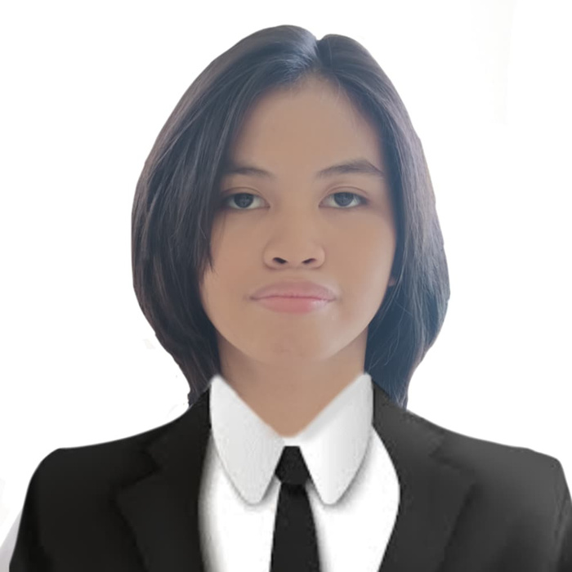

Delos Santos, Hailie Sophie
Team Leader
“ When in doubt, Google nalang. ”

Slide 4
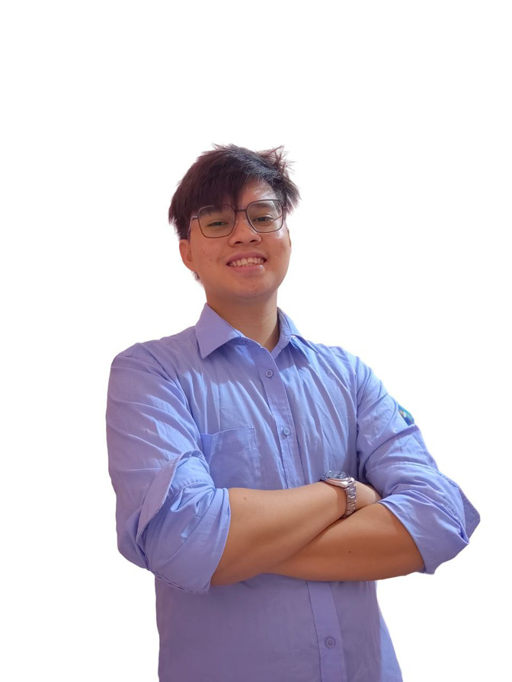
Canta, Raeniel Louis
Developer
“ Don't Give Up, The Beginning is always the hardest"

Slide 5
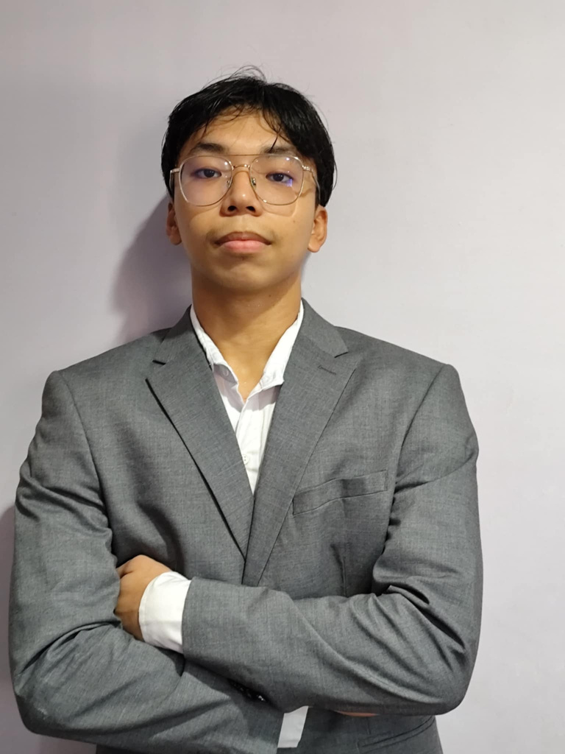
De Lara, Maclery
Developer
“Programming isn’t about what you know, it’s about what you can figure out - Chris Pine”

Slide 6
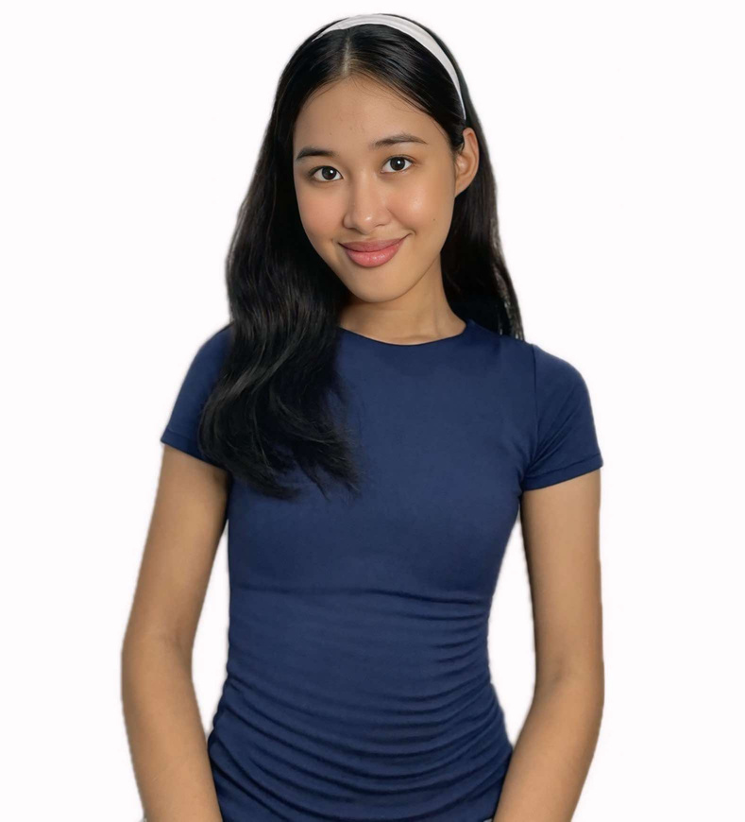
Soriano, Andrea Gail
Project Manager
"Good code is its own best documentation." – Steve McConnell

Slide 7
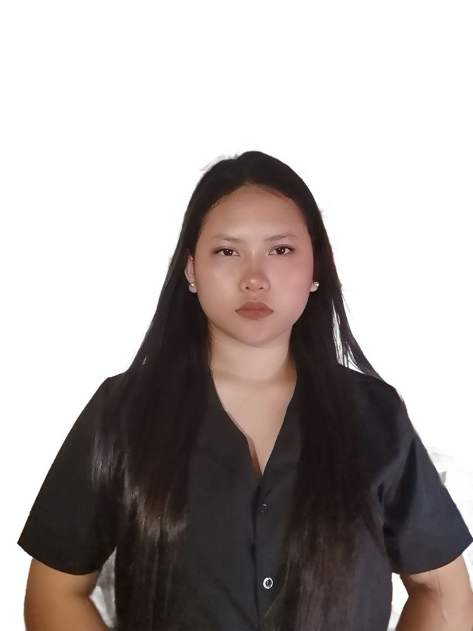
Pamesa, Phoebe
Quality Assurance
“ Work hard until you don’t have to introduce yourself “

Slide 8
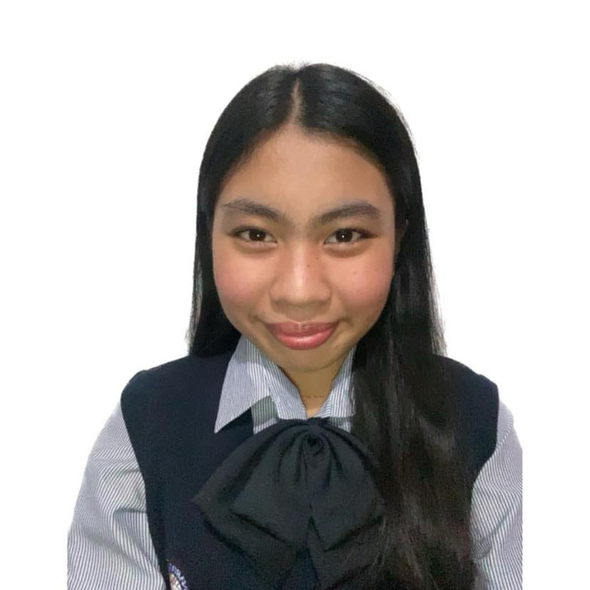
Rabanillo, Ashley Rianne
Quality Assurance
“Normality is a paved road: It's comfortable to walk, but no flowers grow on it.”
— Vincent Van Gogh

Slide 9
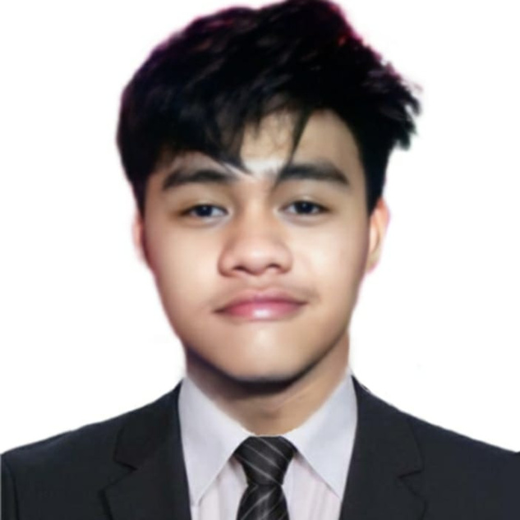
Mina, Chris Ivan
Wild Card
“If you genuinely want something, don’t wait for it–teach yourself to be impatient.” Gurbaksh Chahal

Slide 10



COMFROG
PROBLEMS
PROBLEM 1
PROBLEM 3
Too Many Features at Once. The user finds it overwhelming and confusing.
Students find their lessons hard to learn.
PROBLEM 2
The lack of techniques for learning and understanding

Slide 11



COMFROG
SOLUTION
SOLUTION 1
SOLUTION 2
Made an app for students that will hone their knowledge.
With the help of our app it provides engaging educational games so that the students will be more engaged.
SOLUTION 3
Made our app more concise and less overwhelming.

Slide 12


COMFROG
FEATURES
An educational program called PyCards was implemented by students at Polytechnic University of the Philippines-Parañaque for intellectual, knowledge, and development purposes. PyCards is a tool that allows students to construct their own game reviewer by using flashcards to create a deck of cards that incorporate lessons of their choice, along with answers and meanings. The aim of this study was to help students succeed academically and participate in interactive learning. It's a good engaging tool since you will learn while engaging.

Slide 13


COMFROG
OVERVIEW
OF
THE SYSTEM

Slide 14
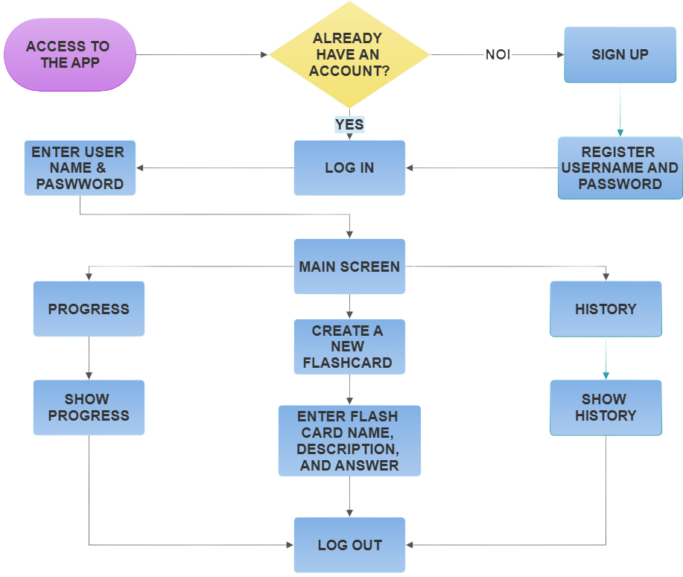

Unveiling the Hardware Heroes

Slide 15

COMFROG
SYSTEM
REQUIREMENTS

Slide 16
COMFROG (Epic/User Stories with Acceptance Criteria)
EPICS | USER STORY | ACCEPTANCE CRITERIA
Epic 1: User Account Set Up | User Story 1: As a PUPian, I want to create an account that I can utilize for the desktop application freely. | ● Given that the user is on the registration page ● When the user enters a valid email and password ● Then the account is created
 | User Story 2: As a PUPian, I want to input my account and my password so I can access my existing account on the desktop application | ● Given that the user is on the login page ● When the user input their email and password ● Then the user would be able to access their existing account

Slide 17
COMFROG (Epic/User Stories with Acceptance Criteria)
Epic 2: Flashcard Creation | User Story 3: As a PUPian, I want to have a flashcard folder where I can input my decks so that I can manage and organize my lessons and topics that I can study later on effectively. | ● Given that the user wants to organize their topics and lessons ● When the user creates a new folder ● Then the folder is created with specified title and descriptions
 | User Story 4: As a PUPian, I want to have a flashcard where I can add notes and explanations for deeper understanding. | ● Given that the user is creating a flashcard ● When the user adds notes and explanations to the back of the card ● Then the notes and explanations are saved and can be viewed
 | User Story 5: As a PUPian, I want to edit existing flashcards si that I can update or correct informations | ● Given that the user wants to edit an existing flashcard ● When the user makes changes and saves them ● Then the changes are updated successfully
 | User Story 6: As a PUPian, I want to delete flashcards that I no longer use so I can keep my study materials organized. | ● Given that the user wants to delete a flashcard ● When the user confirms the deletion ● Then the flash card is removed permanently

Slide 18
COMFROG (Epic/User Stories with Acceptance Criteria)
EPIC 3: Flashcard Game Interactive Learning | User Story 7: As a PUPian, I want to start the game and answer my own deck based on the definition I give, with time and number of lives limited to make it more exciting and challenging. | ● Given that the user selects a deck of flashcards ● When the user starts a game session ● Then the game starts with the selected deck and limited lives
 | User Story 8: As a PUPian, I want to receive immediate feedback on my errors and progress | ● Given that the user is playing the game ● When the user answers a question ● The immediate feedback is provide
EPIC 4: Progress tracking | User Story 9: As a PUPian, I want to view history of my game sessions so that I can track my progress over time | ● Given that the user wants to view past game sessions ● When the user clicks the history button ● Then the history is displayed with date, time, and performance metrics
 | User Story 10: As a PUPian, I want to see my average score and statistics so that I can see how well I am doing. | ● Given that the user wants to track performance over time ● When the user views their statistics ● Then the average score and other performances data are presented clearly

Slide 19
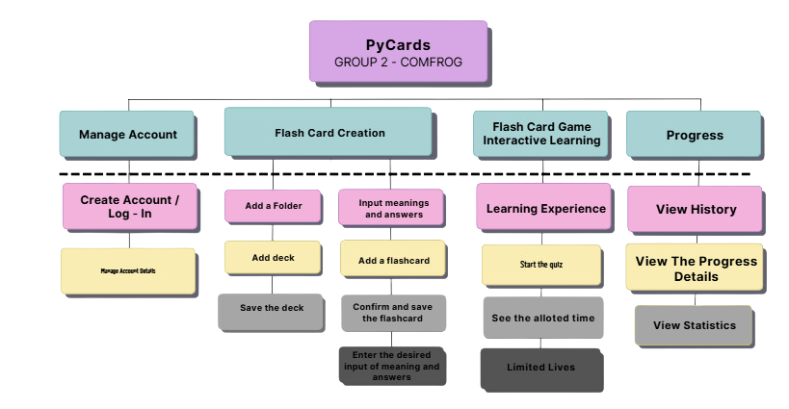
Unveiling the Hardware Heroes
COMFROG (User Story Mapping)

Slide 20
COMFROG
PROJECT
TIMELINE
AND
MILESTONES

Slide 21
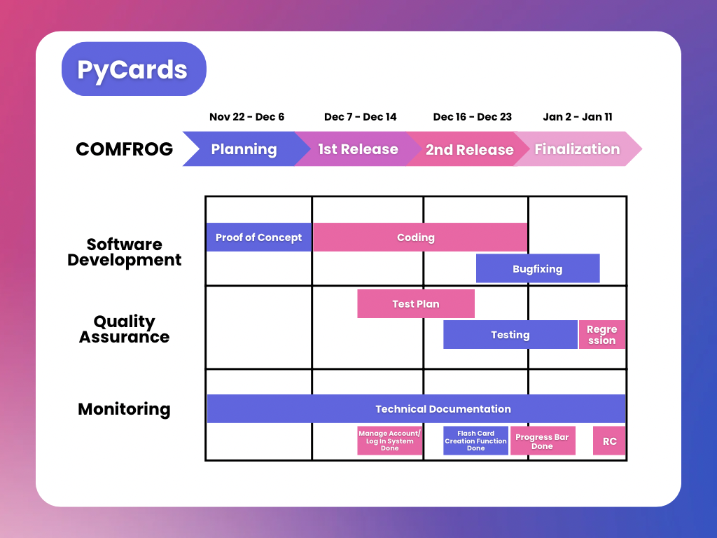
Unveiling the Hardware Heroes
COMFROG

Slide 22
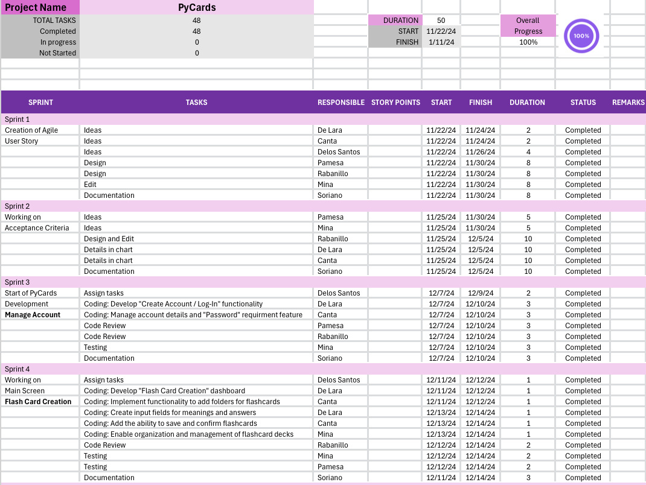
Unveiling the Hardware Heroes
COMFROG (Gannt Chart)

Slide 23
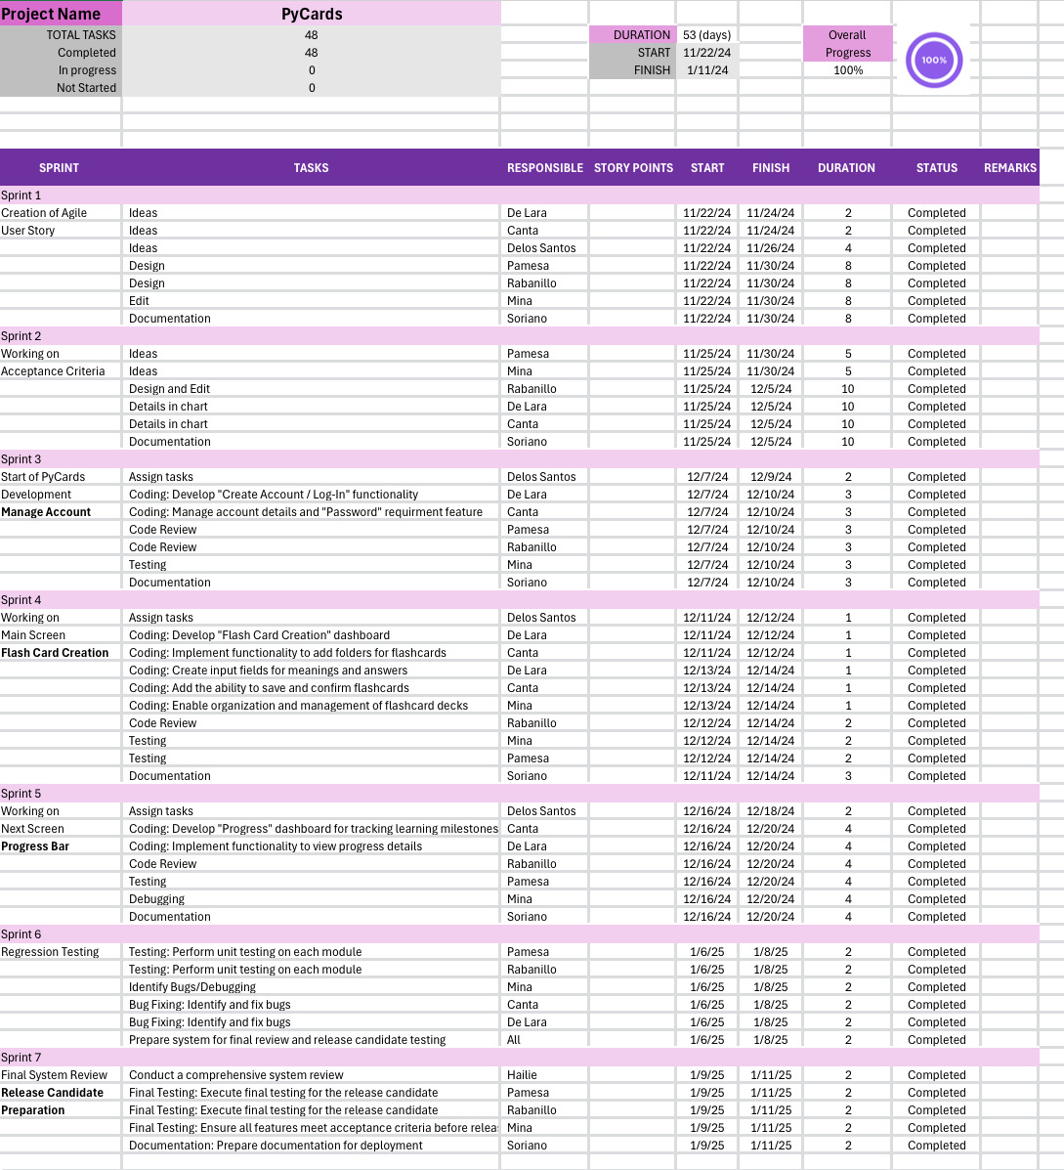
Unveiling the Hardware Heroes
COMFROG (Gannt Chart)

Slide 24
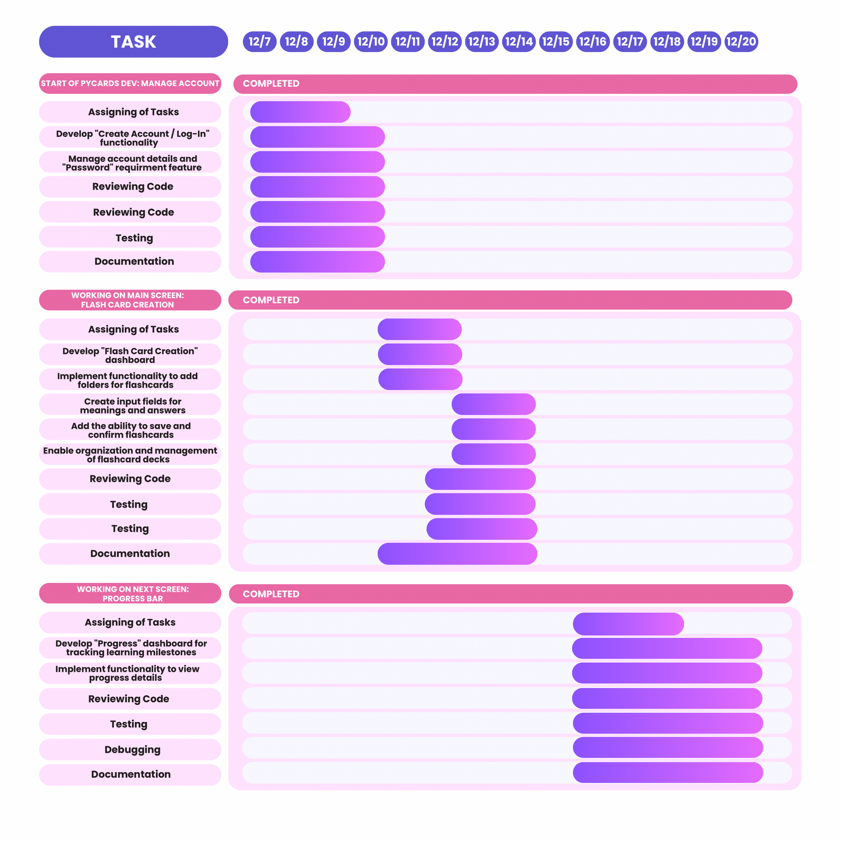
Unveiling the Hardware Heroes
COMFROG (Gannt Chart)

Slide 25
Unveiling the Hardware Heroes
COMFROG (Gannt Chart)

Slide 26
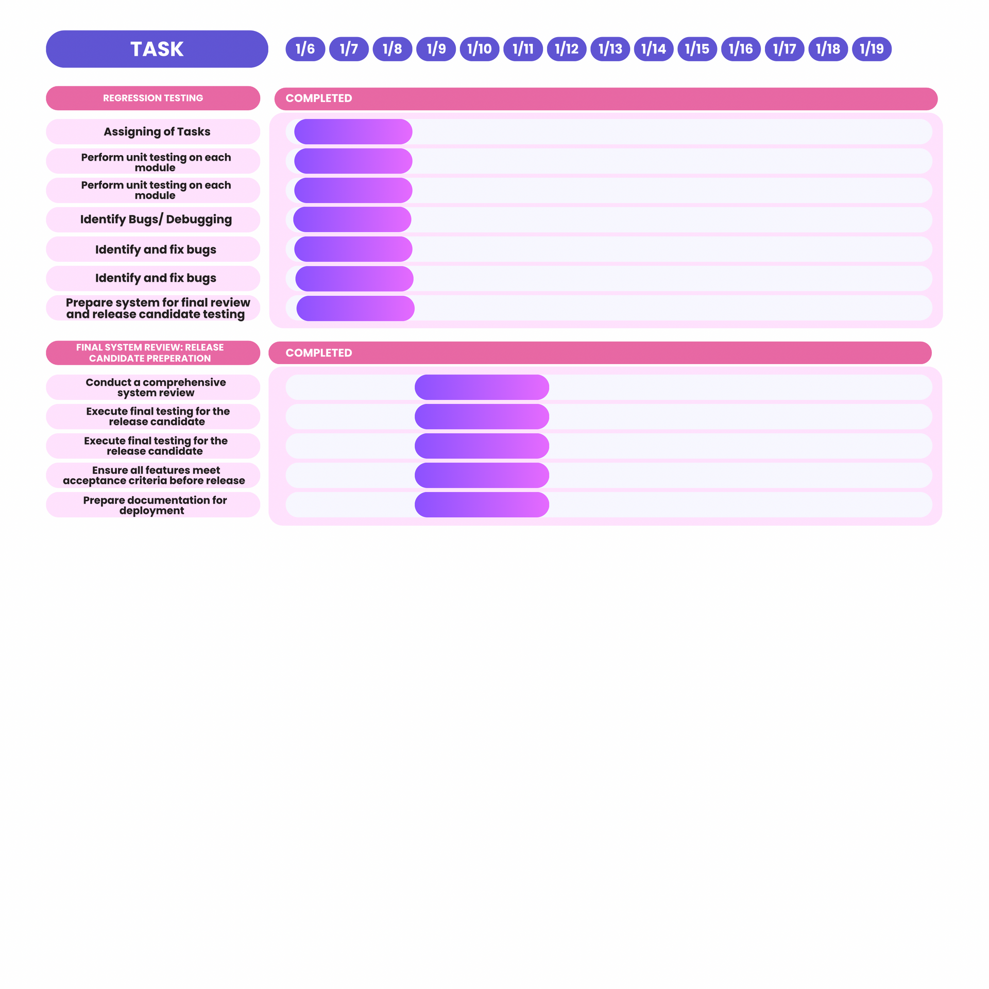
Unveiling the Hardware Heroes
COMFROG (Gannt Chart)

Slide 27
COMFROG
TEST CASES
and
TEST RESULTS

Slide 28
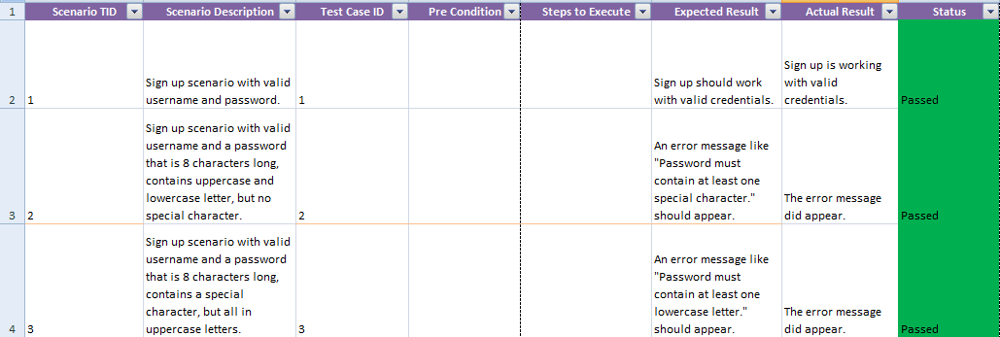
Unveiling the Hardware Heroes
COMFROG

Slide 29
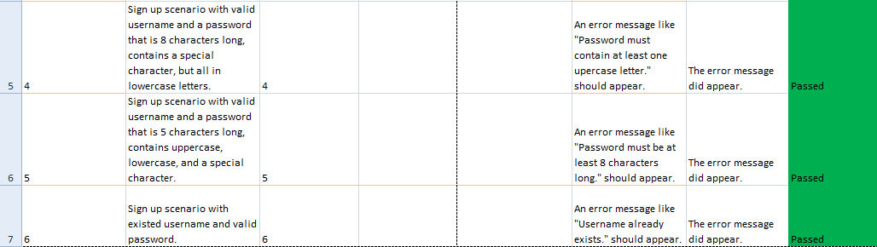
Unveiling the Hardware Heroes
COMFROG

Slide 30
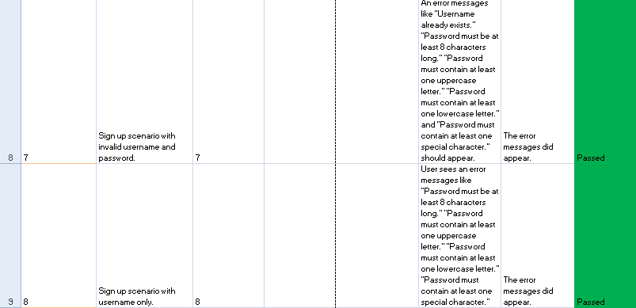
Unveiling the Hardware Heroes
COMFROG

Slide 31
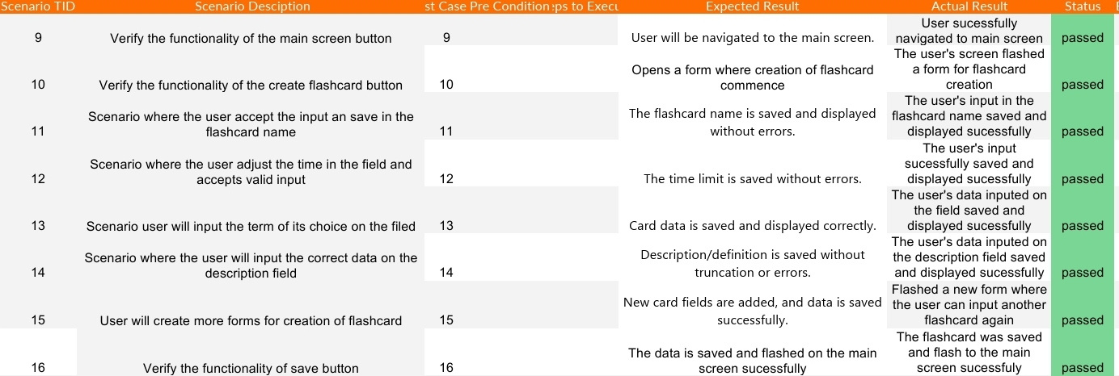
Unveiling the Hardware Heroes
COMFROG

Slide 32
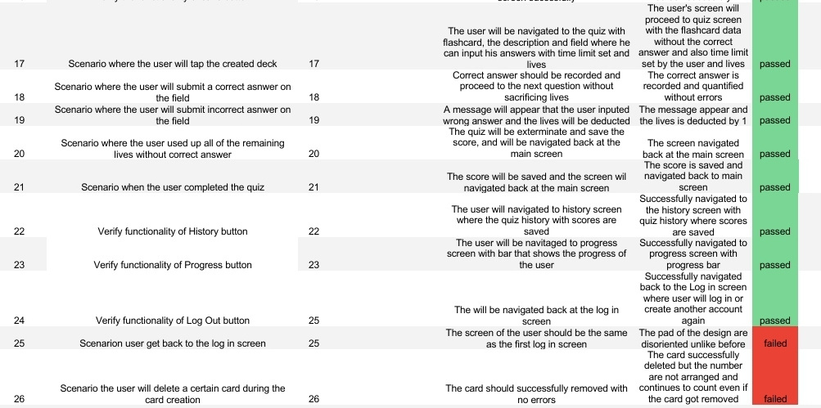
Unveiling the Hardware Heroes

Slide 33
COMFROG
SUMMARY
AND
CONCLUSION

Slide 34
Unveiling the Hardware Heroes
COMFROG
Pycards was developed to further improve and simplify learning for students and be more manageable for professors and lecturers alike. With Pycards, learning and teaching is more manageable and easy for both students and professors alike within Polytechnic University of the Philippines-Parañaque. With the help of our team, we are able to create, test, and finalize Pycards to its full funcuality.

Slide 35

COMFROG
DOCUMENTATION

Slide 36
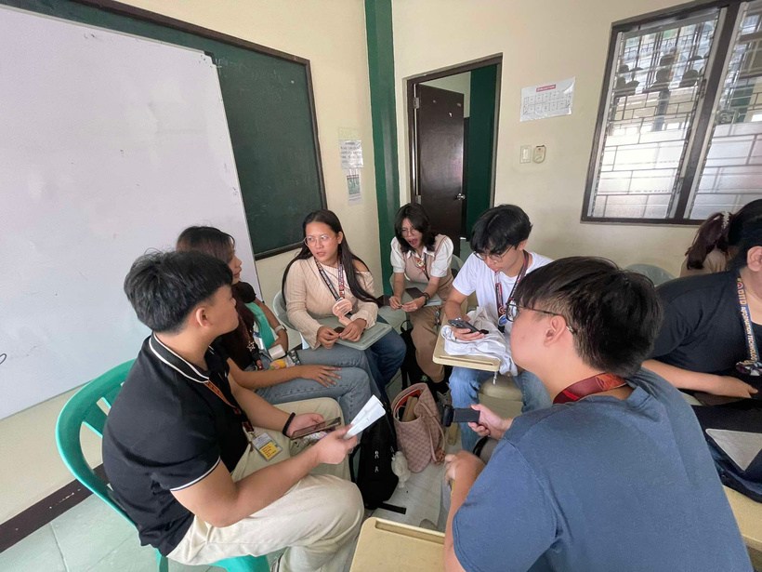
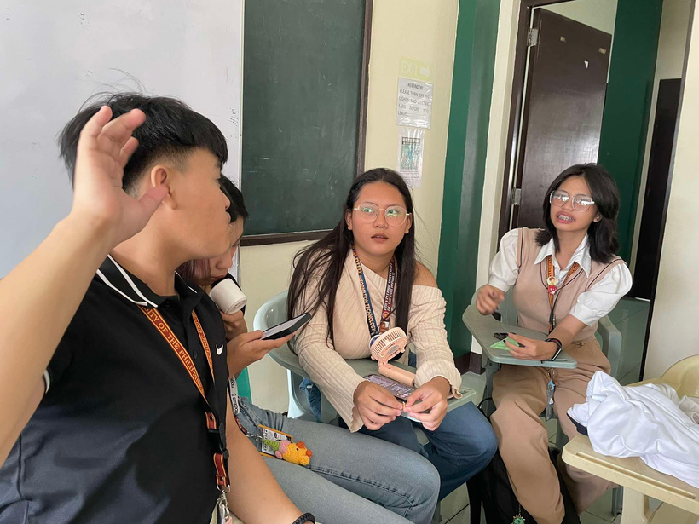
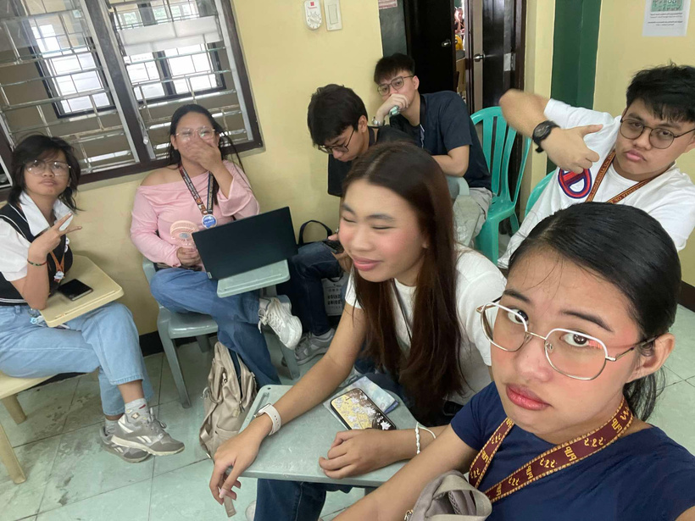
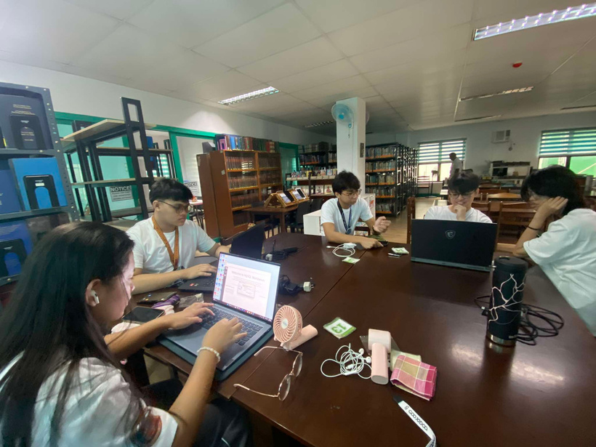
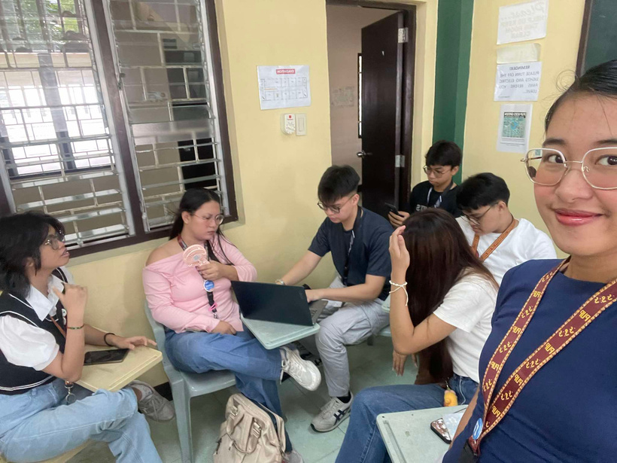

Slide 37
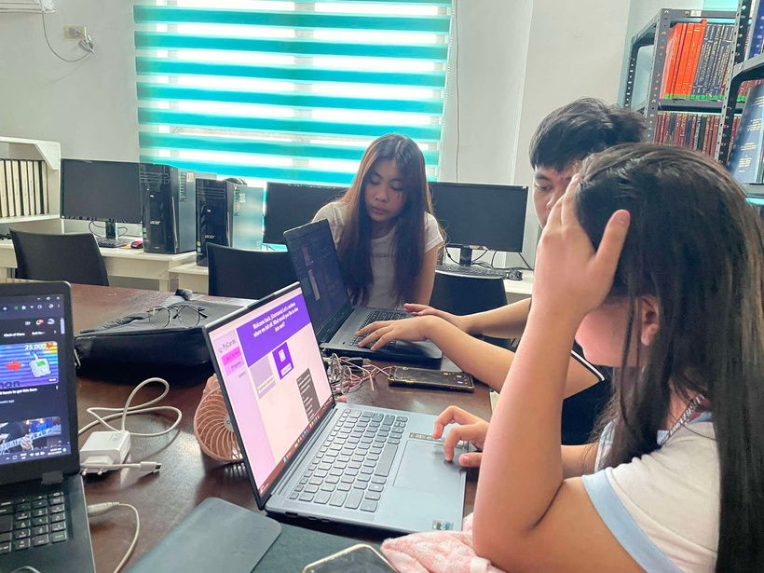
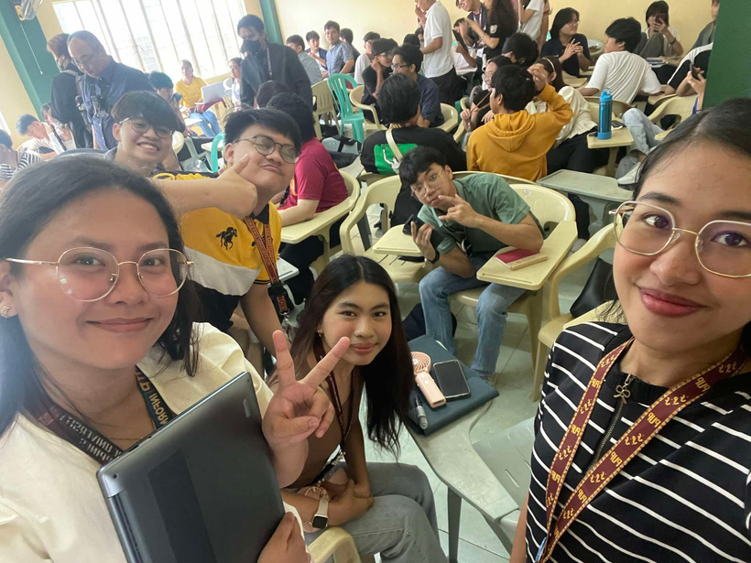
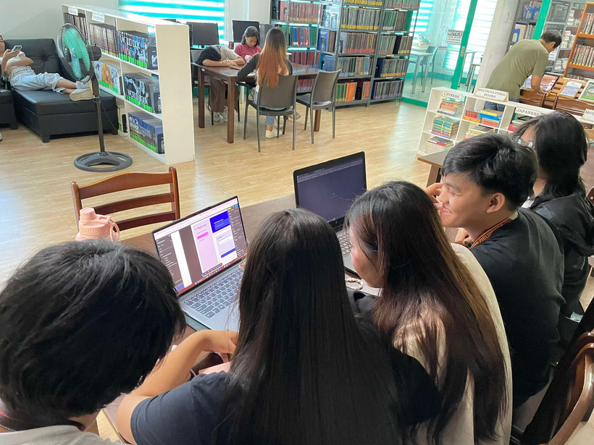
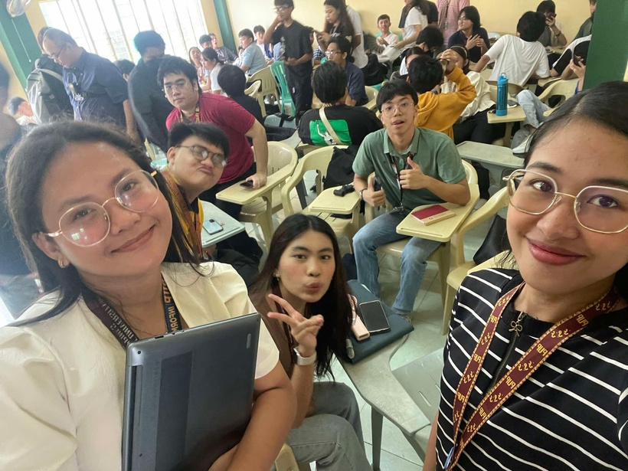
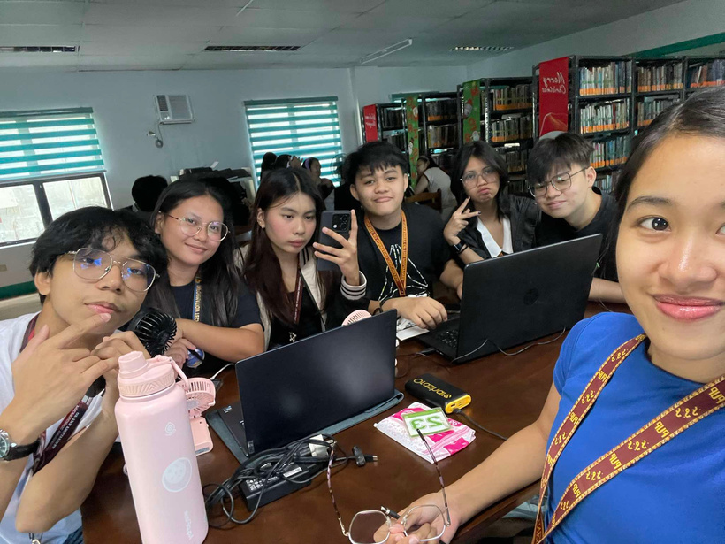

Slide 38
COMFROG
SCREENSHOTS

Slide 39
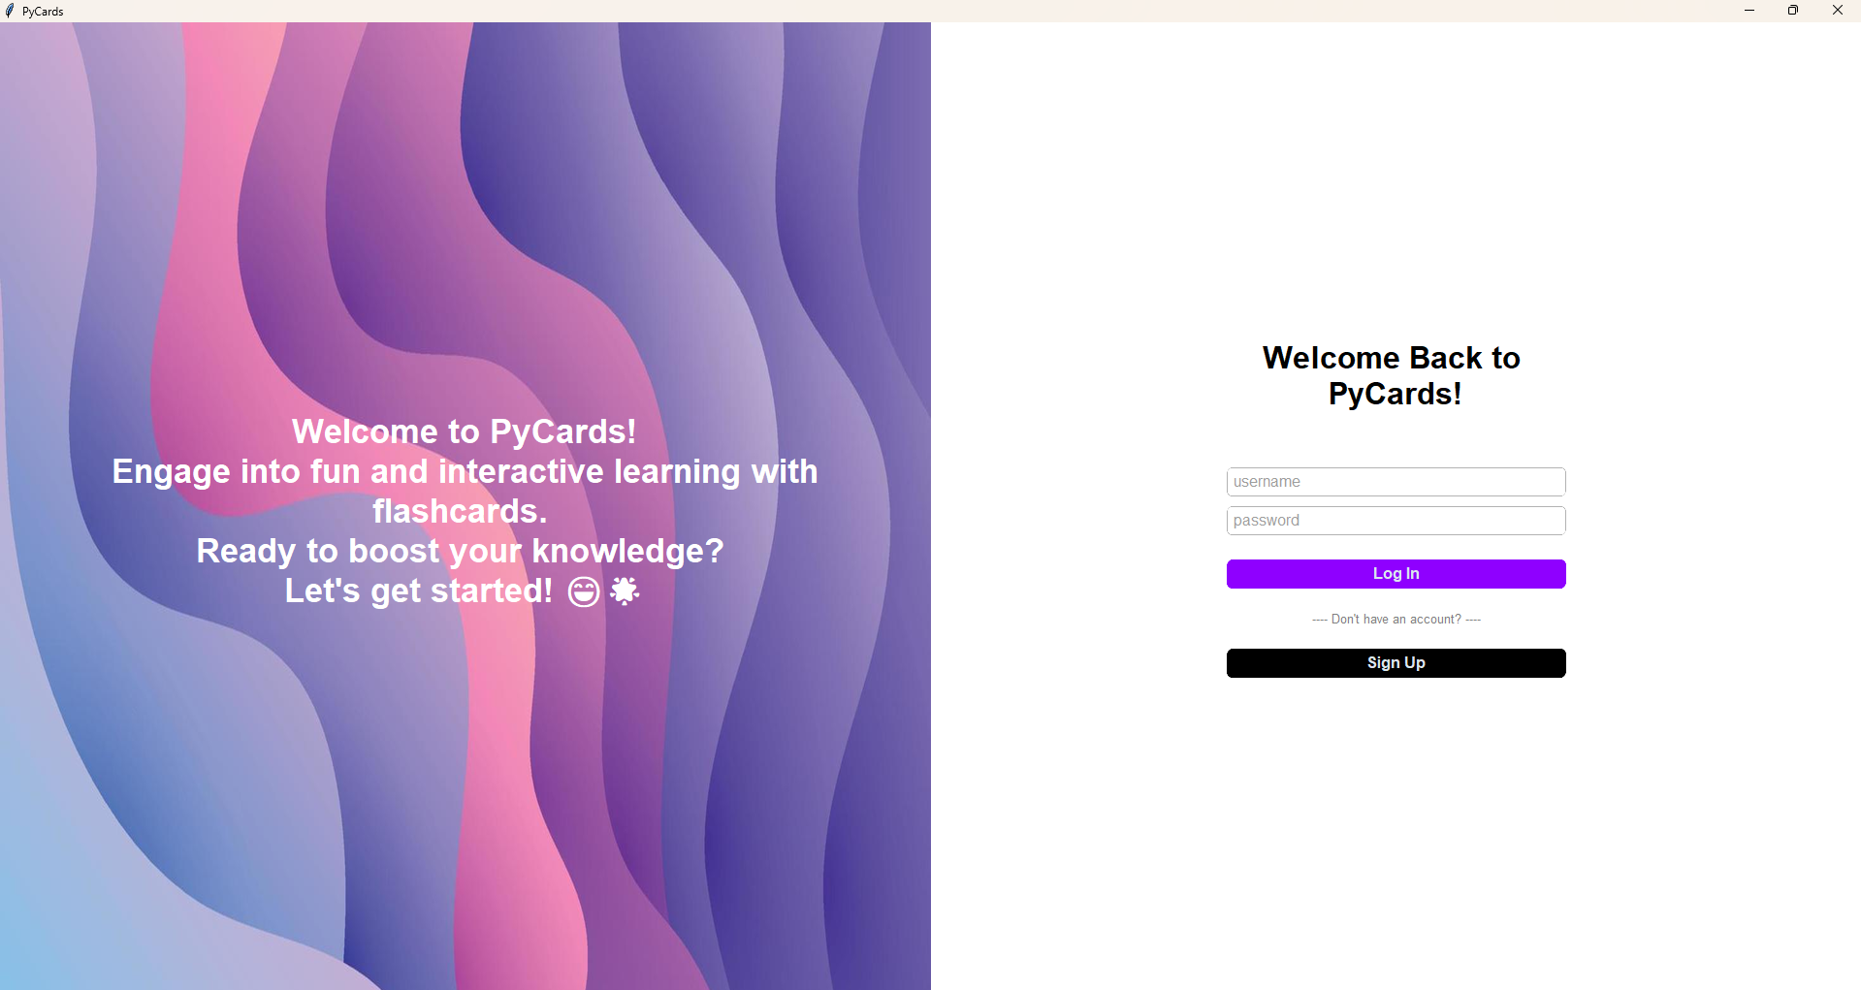
Unveiling the Hardware Heroes

Slide 40
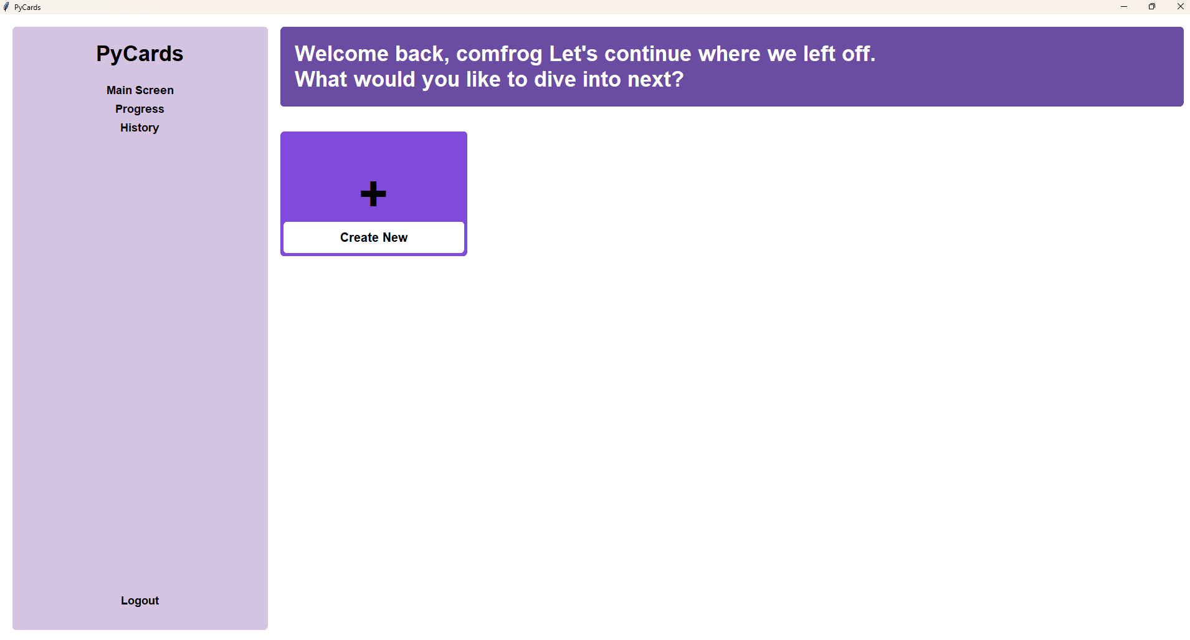
Unveiling the Hardware Heroes

Slide 41
COMFROG
DEMO

Slide 42
COMFROG
THANK YOU!

